Slide 1
Splay Trees and B-Trees
CSE 373
Data Structures
Lecture 9

Slide 2
Readings
Reading
  Sections 4.5-4.7

Slide 3
Self adjusting Trees
Ordinary binary search trees have no balance conditions
  what you get from insertion order is it
Balanced trees like AVL trees enforce a balance condition when nodes change
  tree is always balanced after an insert or delete
Self-adjusting trees get reorganized over time as nodes are accessed
  Tree adjusts after insert, delete, or find

Slide 4
Splay Trees
Splay trees are tree structures that:
  Are not perfectly balanced all the time
  Data most recently accessed is near the root. (principle of locality; 80-20 “rule”)
The procedure:
  After node X is accessed, perform “splaying” operations to bring X to the root of the tree.
  Do this in a way that leaves the tree more balanced as a whole

Slide 5
Splay Tree Terminology
Let X be a non-root node with ≥ 2 ancestors.
  P is its parent node.
  G is its grandparent node.
G
G
G
G
P
P
P
P
X
X
X
X

Slide 6
Zig-Zig and Zig-Zag
Parent and grandparent
in same direction.
Parent and grandparent
in different directions.
Zig-zig
4
G
G
5
P
5
Zig-zag
1
P
X
2
X

Slide 7
Splay Tree Operations
1. Helpful if nodes contain a parent pointer.
parent
element
left
right
2. When X is accessed, apply one of six rotation routines.
Single Rotations (X has a P (the root) but no G)
  ZigFromLeft, ZigFromRight
Double Rotations (X has both a P and a G)
  ZigZigFromLeft, ZigZigFromRight
  ZigZagFromLeft, ZigZagFromRight

Slide 8
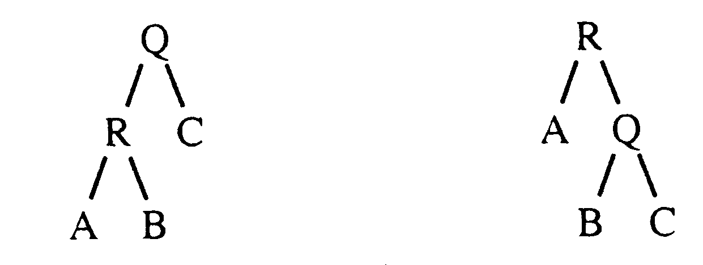
Zig at depth 1 (root)
“Zig” is just a single rotation, as in an AVL tree
Let R be the node that was accessed (e.g. using Find)
ZigFromLeft moves R to the top →faster access next time
root
ZigFromLeft

Slide 9
Zig at depth 1
Suppose Q is now accessed using Find
ZigFromRight moves Q back to the top
root
ZigFromRight

Slide 10
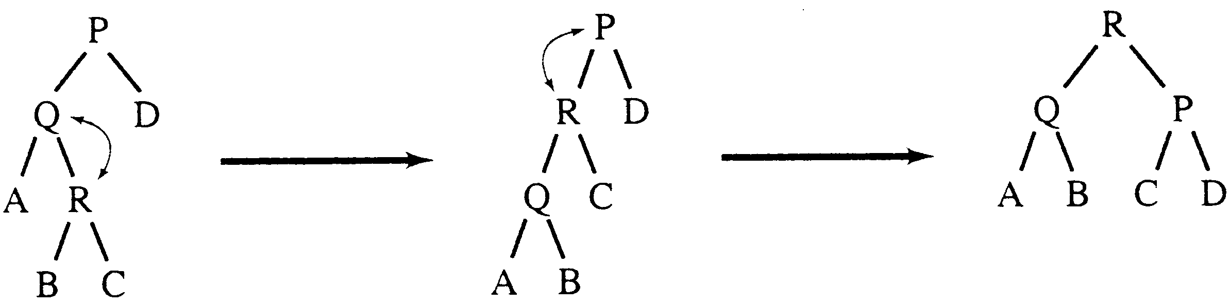
Zig-Zag operation
“Zig-Zag” consists of two rotations of the opposite direction (assume R is the node that was accessed)
(ZigFromRight)
(ZigFromLeft)
ZigZagFromLeft

Slide 11
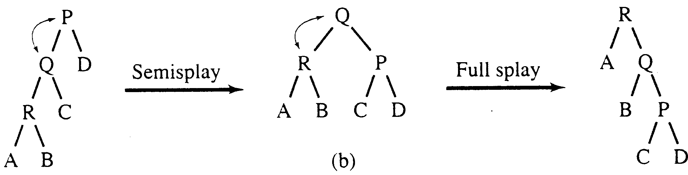
Zig-Zig operation
“Zig-Zig” consists of two single rotations of the same direction (R is the node that was accessed)
(ZigFromLeft)
(ZigFromLeft)
ZigZigFromLeft

Slide 12
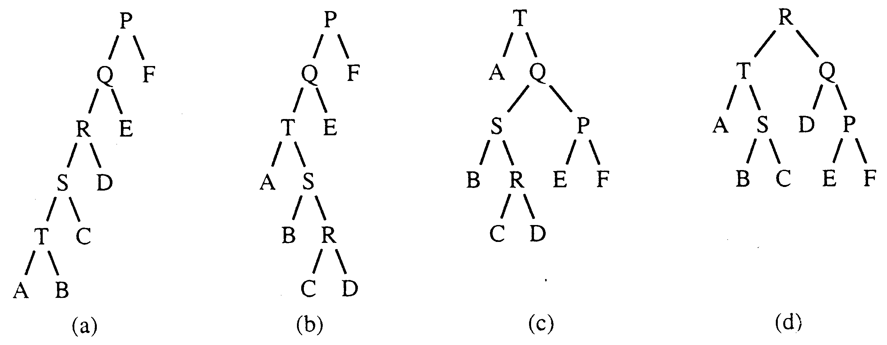
Decreasing depth - "autobalance"
Find(T)
Find(R)

Slide 13
Splay Tree Insert and Delete
Insert x
  Insert x as normal then splay x to root.
Delete x
  Splay x to root and remove it. (note: the node does not have to be a leaf or single child node like in BST delete.) Two trees remain, right subtree and left subtree.
  Splay the max in the left subtree to the root
  Attach the right subtree to the new root of the left subtree.

Slide 14
Example Insert
Inserting in order 1,2,3,…,8
Without self-adjustment
1
2
O(n²) time for n Insert
3
4
5
6
7
8

Slide 15
With Self-Adjustment
1
2
3
1
ZigFromRight
1
2
2
1
3
2
ZigFromRight
2
1
3
1

Slide 16
With Self-Adjustment
4
3
4
2
4
ZigFromRight
3
1
2
1
Each Insert takes O(1) time therefore O(n) time for n Insert!!

Slide 17
Example Deletion
10
splay
(Zig-Zag)
8
5
15
5
10
2
8
13
20
2
6
9
15
13
20
6
9
Splay (zig)
attach
remove
6
5
10
5
10
15
2
6
9
15
2
9
13
20
13
20

Slide 18
Analysis of Splay Trees
Splay trees tend to be balanced
  M operations takes time O(M log N) for M > N operations on N items. (proof is difficult)
  Amortized O(log n) time.
Splay trees have good “locality” properties
  Recently accessed items are near the root of the tree.
  Items near an accessed one are pulled toward the root.

Slide 19
Beyond Binary Search Trees: Multi-Way Trees
Example: B-tree of order 3 has 2 or 3 children per node
Search for 8
13:-
6:11
17:-
3 4
6 7 8
11 12
13 14
17 18

Slide 20
B-Trees
B-Trees are multi-way search trees commonly used in database systems or other applications where data is stored externally on disks and keeping the tree shallow is important.
A B-Tree of order M has the following properties:
1. The root is either a leaf or has between 2 and M children.
2. All nonleaf nodes (except the root) have between ⎡M/2⎤
and M children.
3. All leaves are at the same depth.
All data records are stored at the leaves.
Internal nodes have “keys” guiding to the leaves.
Leaves store between ⎡M/2⎤ and M data records.

Slide 21
B-Tree Details
Each (non-leaf) internal node of a B-tree has:
  Between ⎡M/2⎤ and M children.
  up to M-1 keys k₁ < k₂ < ... < k_{M-1}
k₁
. . .
k_{i-1}
k_{i}
. . .
k_{M-1}
Keys are ordered so that:
k₁ < k₂ < ... < k_{M-1}

Slide 22
Properties of B-Trees
k
k
k
. . .
k
k
k
1
. . .
i-1
k
i
M-1
i
T
. . .
. . .
T
T
T
T
1
T
1
i
i
M
Children of each internal node are "between" the items in that node.
Suppose subtree T_{i} is the ith child of the node:
  all keys in T_{i} must be between keys k_{i-1} and k_{i}
  i.e. k_{i-1} ≤ T_{i} < k_{i}
k_{i-1} is the smallest key in T_{i}
All keys in first subtree T₁ < k₁
All keys in last subtree T_{M} ≥ k_{M-1}

Slide 23
Example: Searching in B-trees
B-tree of order 3: also known as 2-3 tree (2 to 3 children)
Examples: Search for 9, 14, 12
Note: If leaf nodes are connected as a Linked List, B-tree is called a B+ tree – Allows sorted list to be accessed easily
13:-
- means empty slot
6:11
17:-
3 4
6 7 8
11 12
13 14
17 18

Slide 24
Inserting into B-Trees
Insert X: Do a Find on X and find appropriate leaf node
  If leaf node is not full, fill in empty slot with X
    E.g. Insert 5
  If leaf node is full, split leaf node and adjust parents up to root node
    E.g. Insert 9
13:-
6:11
17:-
3 4
6 7 8
11 12
13 14
17 18

Slide 25
Deleting From B-Trees
Delete X : Do a find and remove from leaf
  Leaf underflows – borrow from a neighbor
    E.g. 11
  Leaf underflows and can’t borrow – merge nodes, delete parent
    E.g. 17
13:-
6:11
17:-
3 4
6 7 8
11 12
13 14
17 18

Slide 26
Run Time Analysis of B-Tree Operations
For a B-Tree of order M
  Each internal node has up to M-1 keys to search
  Each internal node has between ⎡M/2⎤ and M children
  Depth of B-Tree storing N items is O(log _{⎡M/2⎤} N)
Find: Run time is:
  O(log M) to binary search which branch to take at each node. But M is small compared to N.
  Total time to find an item is O(depth*log M) = O(log N)

Slide 27
Summary of Search Trees
Problem with Binary Search Trees: Must keep tree balanced to allow fast access to stored items
AVL trees: Insert/Delete operations keep tree balanced
Splay trees: Repeated Find operations produce balanced trees
Multi-way search trees (e.g. B-Trees): More than two children
  per node allows shallow trees; all leaves are at the same depth
  keeping tree balanced at all times

